Slide 1
A new method to identify sources of lead and other heavy metal contaminants in house and work place dust in New Zealand and mitigating measures to reduce their health effects
Drs. Ben Keet, FRSC, MRSNZ
Geo & Hydro – K8 Ltd e-mail: ben@benkeet.com

Slide 2
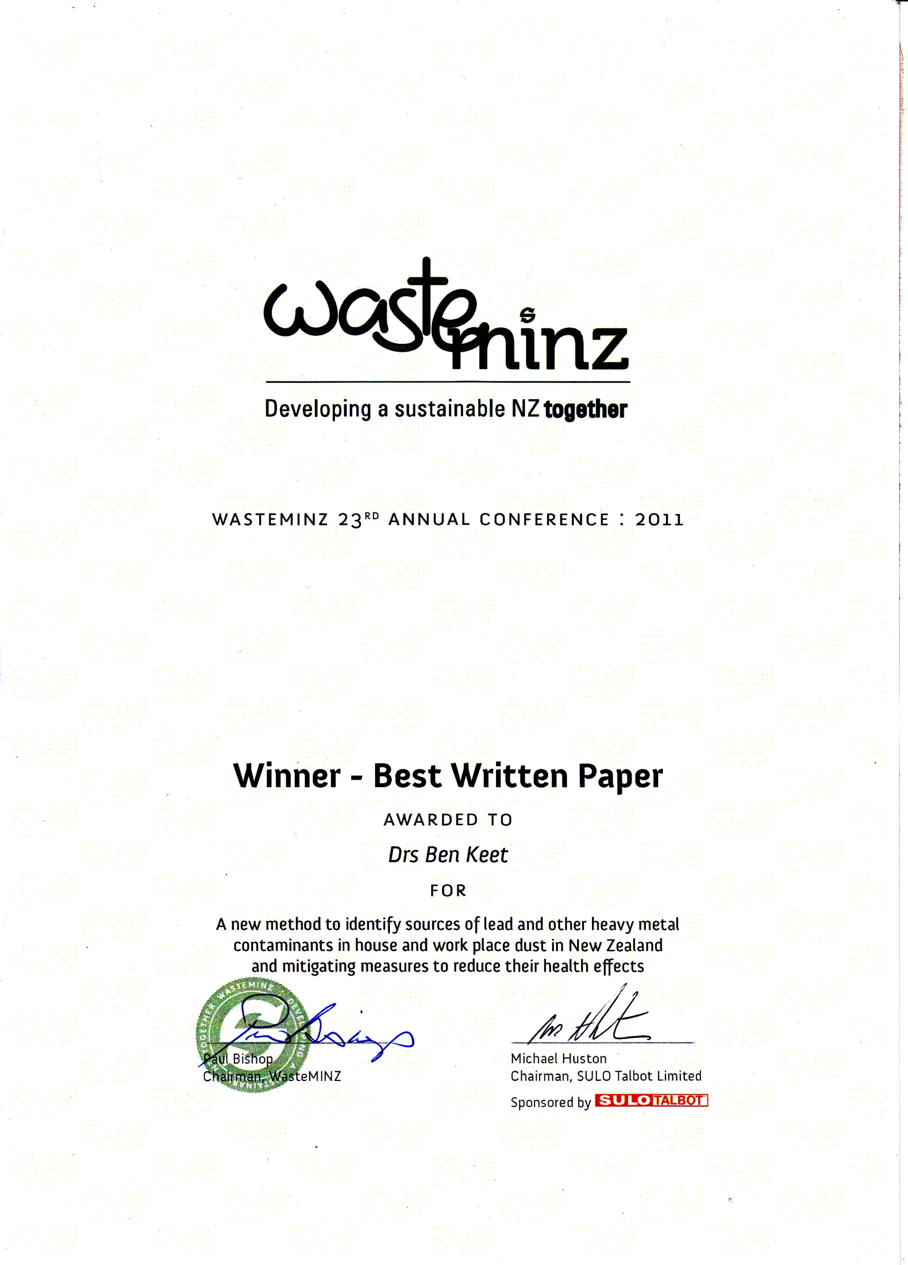

Slide 3
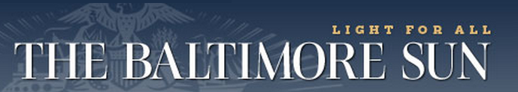
Housing Authority of Baltimore City
is to pay nearly $12 million in court-ordered judgments that it owes
former public housing tenants who suffered lead-paint poisoning years ago as children.
By Scott Calvert, The Baltimore Sun8:59 a.m. EDT, August 18, 2011
http://www.baltimoresun.com/health/bs-md-brochin-lead-paint-20110817,0,7720622.story?goback=%2Egde_164261_member_68234249

Slide 4
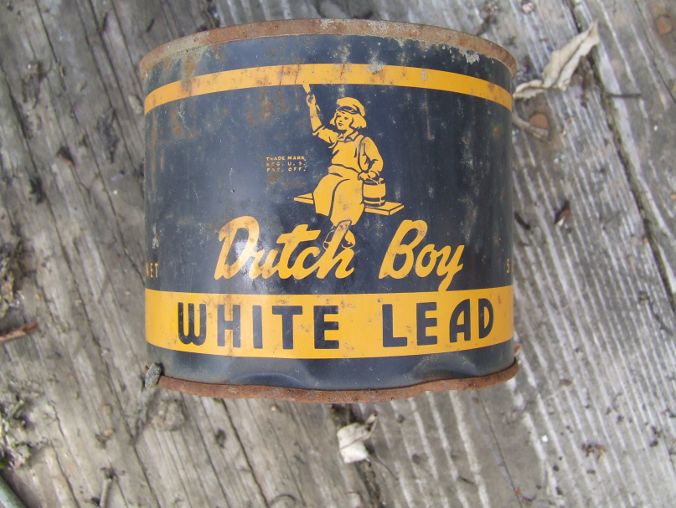
Lead-based paint history
Pre-1945 paint > 50% Pb
Start phase out late ‘60-ies
Still in use in mid ‘80-ies

Slide 5
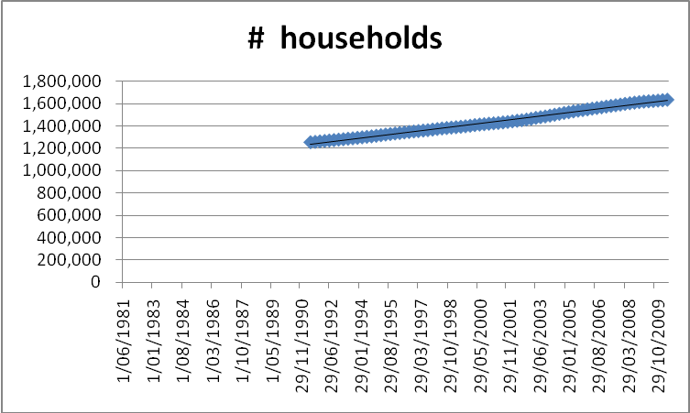
1980 - 1.000.000 households in NZ
1984 BRANZ estimates:
251.000 properties with lead based paint
Ref. NZ Statistics

Slide 6
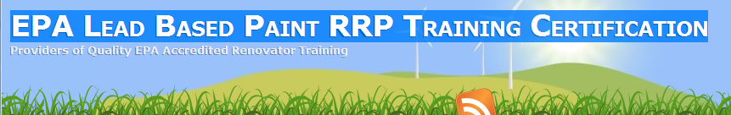
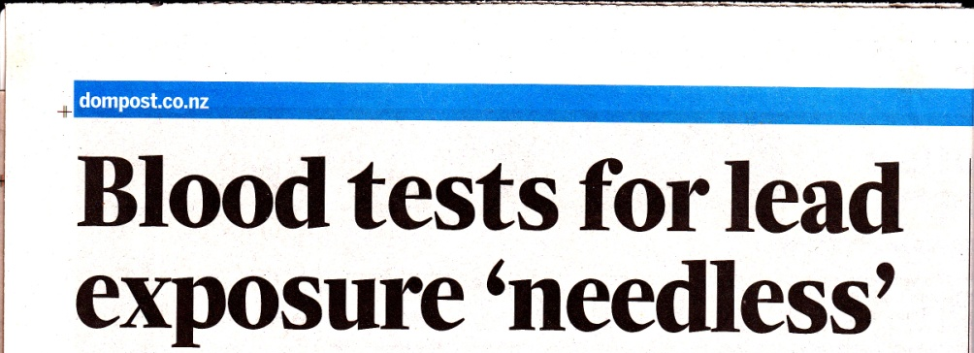
Difference US - NZ
US
RRP = Renovation Repair Painters
On (new date) January 1, 2011, firms working in pre-1978 homes and child-occupied facilities must be certified and use lead-safe work practices during renovations.
The penalty for noncompliance is $37,000 per day, per violation and possible jail time
NZ
Dominion Post 27 July 2011
Are we taking Lead serious in NZ?

Slide 7
Guidelines & How to quantify ?
Lead loading
= Sum of all surface areas containing lead
Good correlation with lead in blood
Hard to quantify (wipe test)
Current clearance standards (USEPA):
Floors: 100 μg/ft²
Window sills: 500 μg/ft²
Window wells: 800 μg/ft²
Lead concentration
= Concentration in house dust
Poor correlation with lead in blood
Easy to quantify (dust sample)
Current Guideline levels (USEPA)
Signal level: 300 mg/kg
Alarm level: 1000 mg/kg

Slide 8
Improve dust – blood concentration relationship
Final USEPA report “Sampling house dust for lead” found:
Dust particles up to 200 micron are important for school age kids
Larger particles may be important for pre-school kids
Particles over 2 mm are generally not ingested
(except when biting toys)
No stud to date has correlated lead blood concentration to
dust lead concentration of specific particle size

Slide 9
Our hypotheses:
1 better correlation lead in blood with lead in fine dust
2 Lead concentration in particle seize indicates source
? Could be other factors; lead speciation, bio-availability
Ad 1 Proposed further research to MoH – no interest so far
Ad 2 Determined lead in particle size fractions of house dust
(vacuum cleaner bag)
Initial findings:
Coarse particles containing lead originate mainly from indoors
Fine particles containing lead are carried in house from outdoors

Slide 10
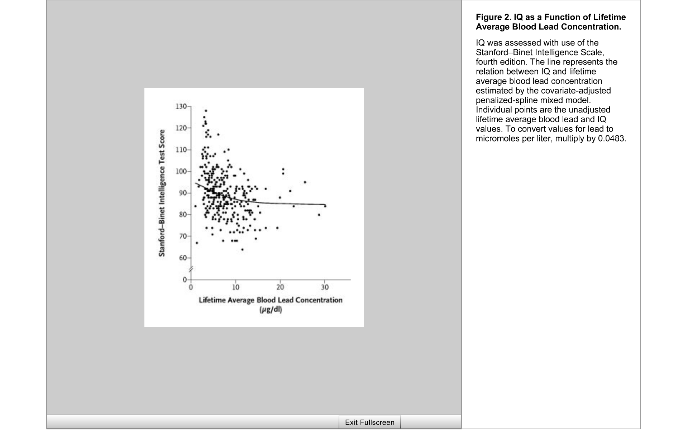
Health Effects
At lead in blood concentration of 10 μg/dl there is a drop of 7 – 15 IQ points
1000 mg/kg in dust raises blood lead by 1 – 10 μg/dl
(large range)
Lead is build in bones, and is ‘recycled’ in the body.
Result: life long poisoning from childhood exposure

Slide 11
Hawke’s Bay study
14 houses surveyed
most showed high lead concentration in house dust
5 gave permission to use results (not the 2 with very high lead levels)
Houses are:
Mid 1980-ies town house
1900 house in orchard
Pre-1900 Bach along coast
1880 villa
1910 villa

Slide 12
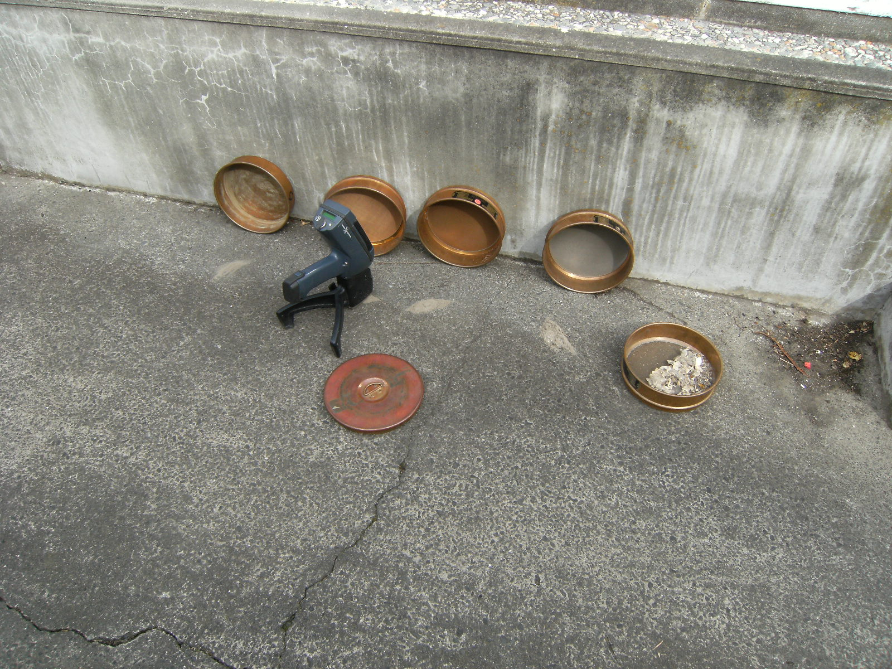
Sampling and Analytical Procedure
Sieve dust from vacuum cleaner bag
Analyse fractions with XRF analyser

Slide 13
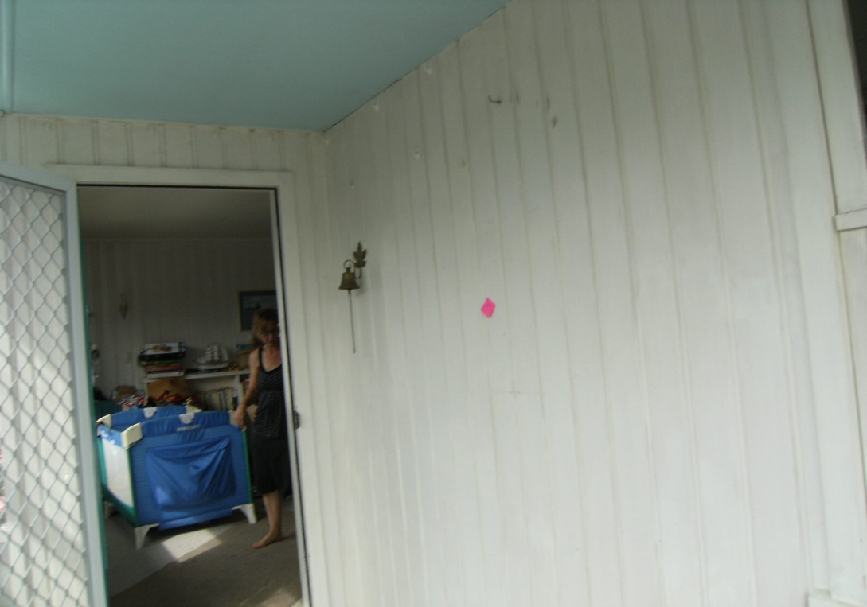
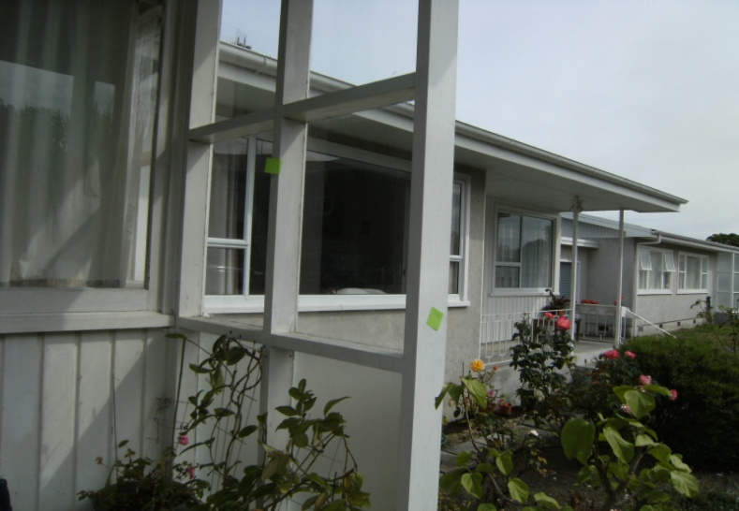
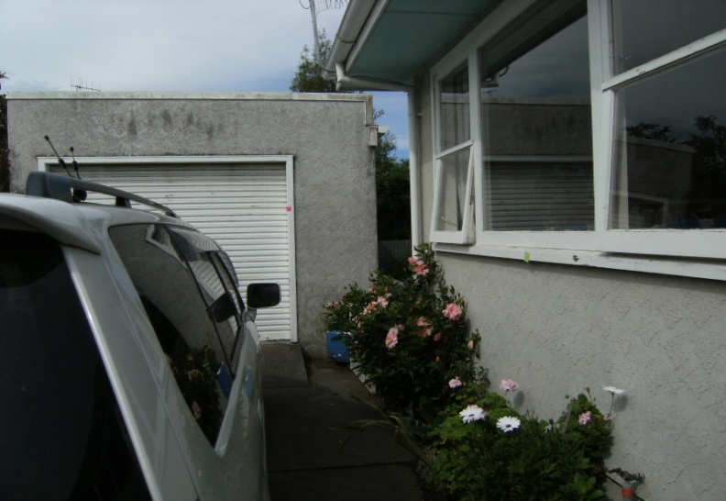
Next analyse painted surfaces
And mark with lead concentration

Slide 14
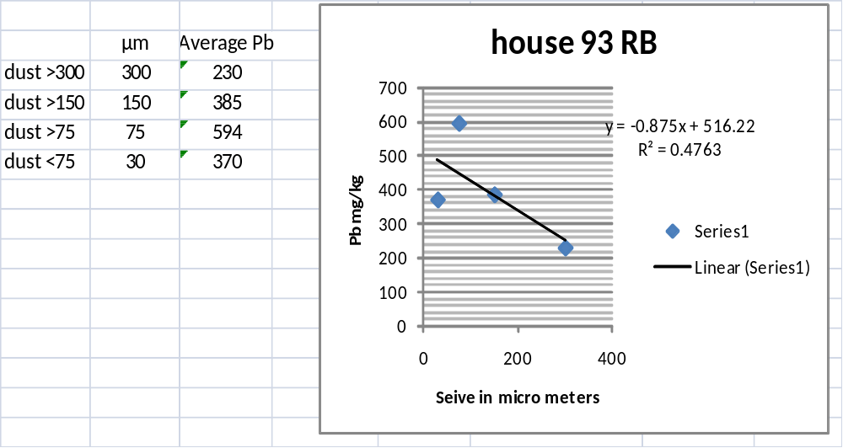
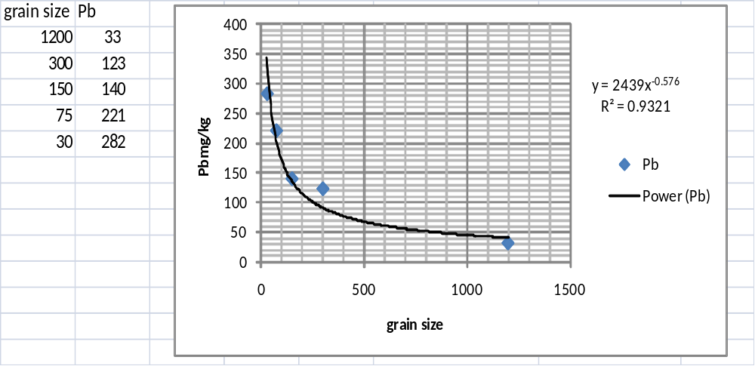
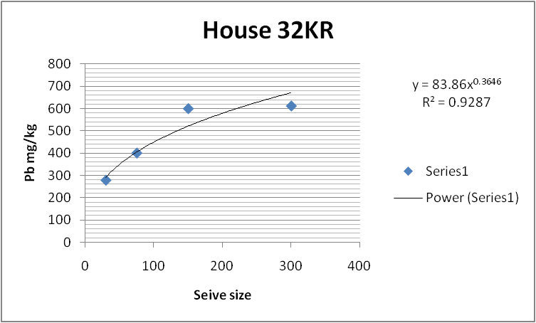
Some results

Slide 15
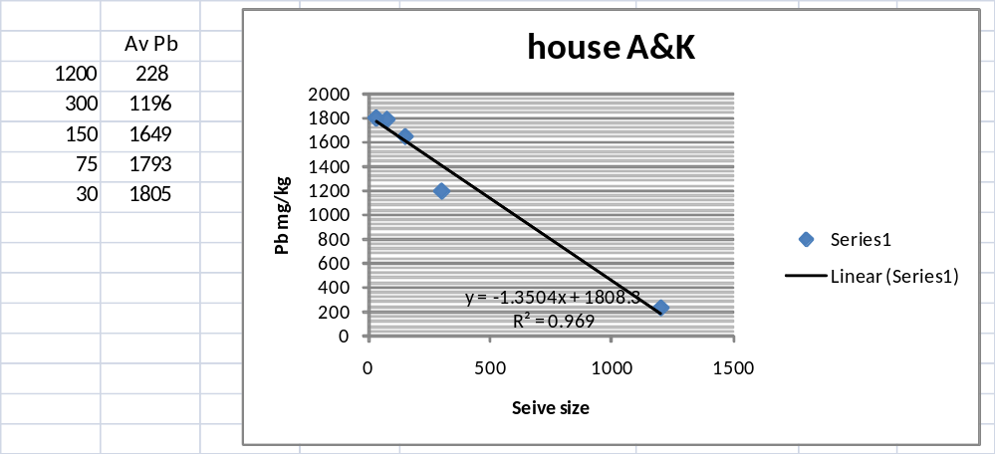
Special case: Home Renovator
 | Dust bag 3 March ‘11 | Dust bag 10 April ‘11 | Dust bag 4 June ‘11
Dust | Average Pb | Average Pb | Average Pb
micron | (mg/kg lead) | (mg/kg lead) | (mg/kg lead)
0-75 | 1805 | 1240 | 573
75-150 | 1793 | 1181 | 606
150-300 | 1649 | 1133 | 529
300-1200 | 1196 | 777 | 462
1200-5000 | 388 | 167 | 183
Note USEPA Action level = 300 mg/kg and Alarm level 1000 mg/kg

Slide 16
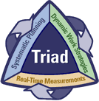

Conclusion: Lead analysis of dust fractions is
Potentially Better
Significantly Cheaper
Using dust from vacuum cleaner bag provides:
House average lead concentration in dust
Rapid assessment of potential lead exposure
Significant savings compared to wipe tests
Can be carried out off-site
On site advantage is option to analyse painted surfaces and soil
Recommended remediation:
Clean surfaces with ammonia / sugar soap solution
Re-paint with acrylic based paint

Slide 17
Recommendations
Study relationship lead in dust fractions with lead in blood
Lead dust surveys should be carried out in all pre 1980 houses with small children
Lead dust surveys should be recommended by Plunket
Testing for lead in blood of pregnant woman and babies should become standard in NZ (as in is in the US and many EU countries)
DHB’s and councils should subsidise remedial work (re-painting) of older houses, especially for households with young kids.

Slide 18
Thank you for your attention
Reminder:
Housing Authority of Baltimore City
is to pay nearly $12 million in court-ordered judgments that it owes
former public housing tenants who suffered lead-paint poisoning years ago as children.
By Scott Calvert, The Baltimore Sun8:59 a.m. EDT, August 18, 2011
http://www.baltimoresun.com/health/bs-md-brochin-lead-paint-20110817,0,7720622.story?goback=%2Egde_164261_member_68234249

